Slide 1
BANK DEPOSIT PREDICTION
EXPLORATORY DATA ANALYSIS AND MACHINE LEARNING
CONTRIBUTORS : GIRISH VANKUDRE

Slide 2
ABOUT DATA
The data given is of cash deposits made in particular branches of a bank.
  Serial Number : Unique identifier for each data point relationship
  Main Office : Signifies if the deposit made at main office. 0 meaning No and 1 meaning Yes
  Branch Number : Identification number of certain branch or branches
  Establishment Date and Acquired Date : Date at which bank branch was established and acquired by specific bank franchise
  City, County and State : Geographical details of the bank branch
  Year Deposits Variable (2013 Deposits, 2014 Deposits) : Deposit amount in US Dollars for specific branch for specific year
Objective : The objective is to predict the cash deposit amount for branches for the year of 2016 ("2016 Deposits" variable)

Slide 3
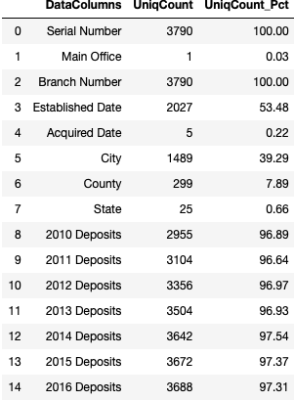
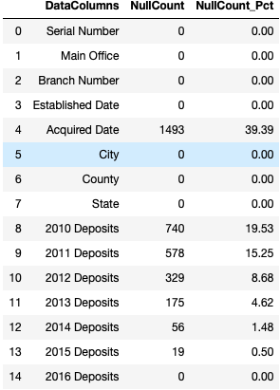
UNDERSTANDING DATA, CLEANING AND PREPROCESSING
Drop Serial Number as a column as no value addition provided.
Main Office has only unique value as ‘0’ (Not a Main Office). Keep the column since we may receive a data in future where deposits are available at Main Office.
Branch Number is again categorically identifying particular branch location. We would tweak the field with its geographical identifiers to make it more useful.
Establishment Date column is converted to age of the branch as of today. This will be useful in EDA and further giving numerical importance to date field.
Acquired Date is converted to binary value as ‘1’ (Branch status as Acquired) and ‘0’ (Branch Status as Not Acquired)
City, County and State is required for EDA purpose only.
We would treat null values of different deposit years by using the logic of fill forward (if 2010 value is null fill it from 2011) instead of removing the null completely.

Slide 4
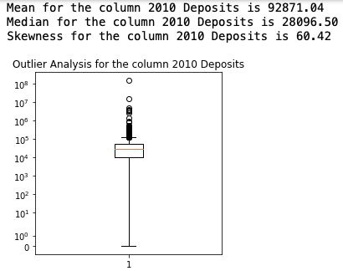
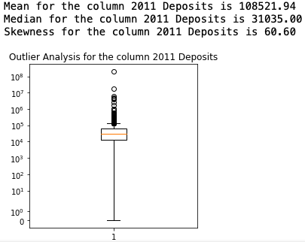
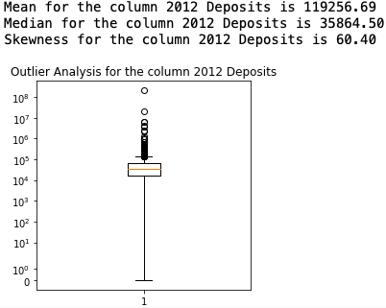
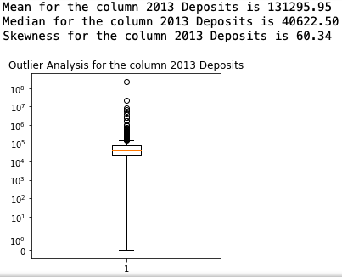
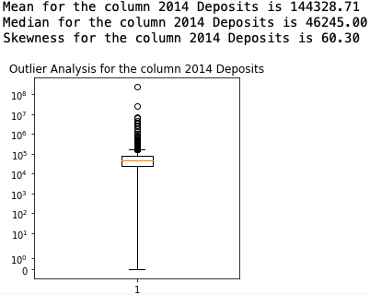
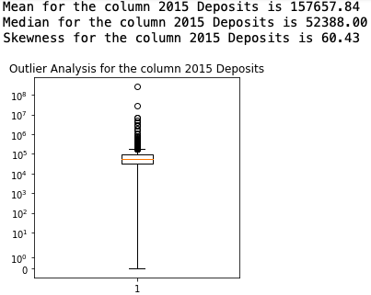
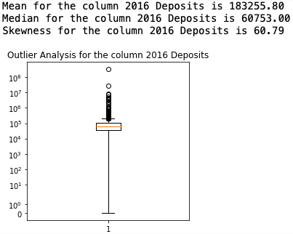
UNDERSTANDING DATA, CLEANING AND PREPROCESSING
In case of Bank deposits we could expect some branches (depending on geographic and demographic advantages) hold extravagantly high amount of deposits. Hence keeping the outliers as it is.
The data seems right/positive skewed as Mean > Median. At the time of model building we would treat the skewness using transformation techniques to improve on the prediction result.

Slide 5
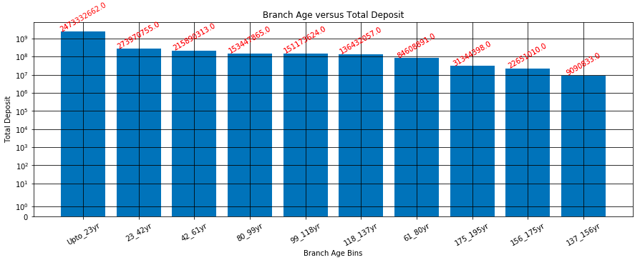
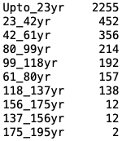
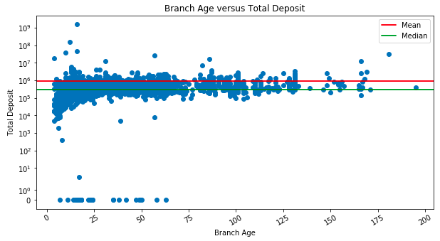
EXPLORATORY DATA ANALYSIS – AGE OF THE BRANCH VERSUS TOTAL DEPOSITS HELD
The newer branches with current age less than 23 years are holding maximum of total deposits. But if we look at the trend for Branch Age versus Total Deposit held then there is no such trend visible.
There are couple of branches opened in last two decades holding very high deposits. But if we compare number of branches opened during last two decades and contributing to total deposits to the older branch deposit holding then we observe that old branches are less in number but holding a significant deposits.
The old branches must be having an additional factor of Trust but for a bank to be on growth track need to blend this Trust with modernization for a good blend of old and new.

Slide 6
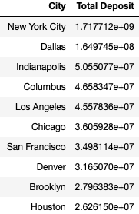
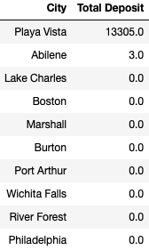
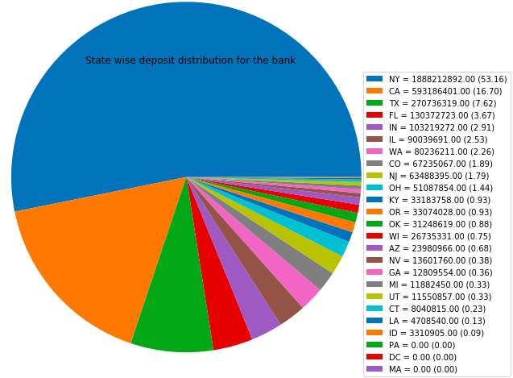
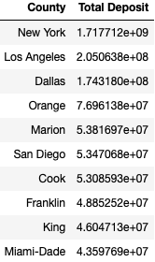
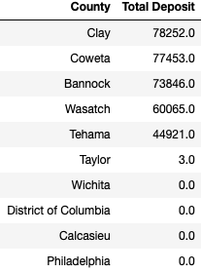
EXPLORATORY DATA ANALYSIS – TOP 10/LEAST 10 CITY/COUNTY/STATE HOLDING DEPOSITS
There 47 branches (spread across 4 Counties/3 states) needs to be looked upon as either the data is not available or branches do not have facility to accept deposits or there is some serious issue with the branch reporting zero amount deposit.
Importance must be given to branches belonging to these branches in order to get correct data or improve on performance or provide facility to accept deposit.

Slide 7
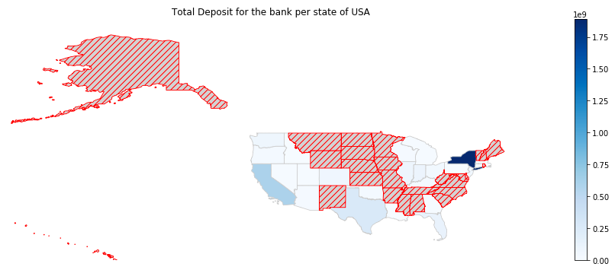
EXPLORATORY DATA ANALYSIS – GEOGRAPHIC DISTRIBUTION OF DEPOSITS HELD
Bank branch presence is not there in most of the Central parts of America on mainland. The state of NY is the most with deposits while rest others are in the mid or low range in terms of total deposits.
The data is either not available for hatched geography or the bank is having no presence in the states.
So the State/County/City of the branch seems to play a role in predicting the deposits a branch could hold.
Assuming that the bank is not having presence in the states, there is a potential for the bank to look for penetrating in the heart of the mainland America.

Slide 8
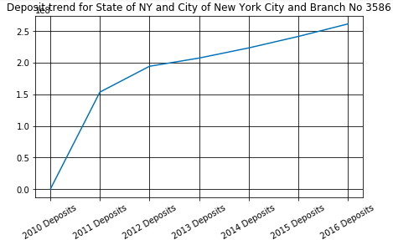
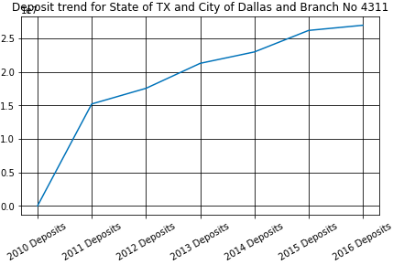
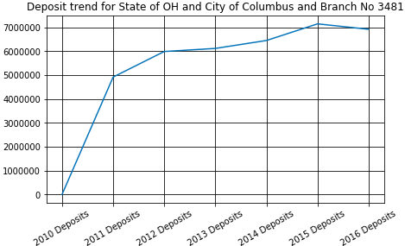
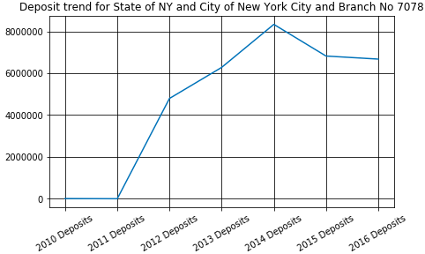
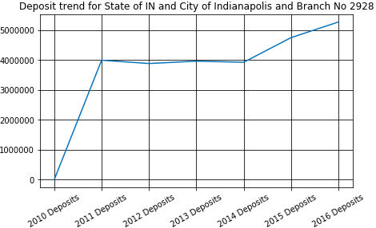
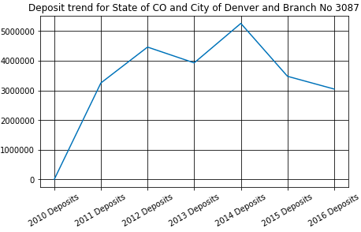
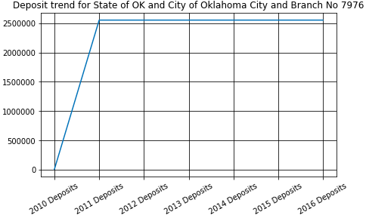
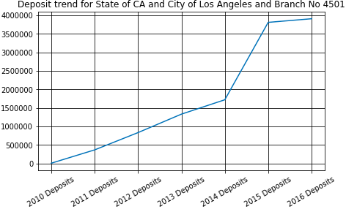
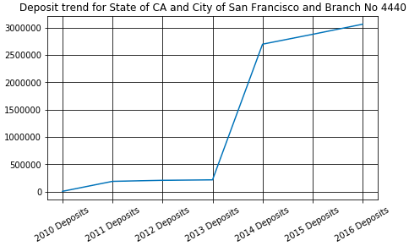
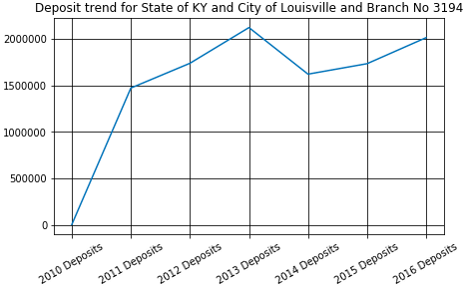
EXPLORATORY DATA ANALYSIS – YOY DEPOSIT TREND FOR TOP10 BRANCHES
There is a mixed trend of Upward and downward for the branches. However there is a branch 7976 in the state of OK showing a flat trend between 2011 and 2016 with a sudden rise from 2010.
Between 2013 and 2015 most of the 10 branches touched their peak deposit holding once.

Slide 9
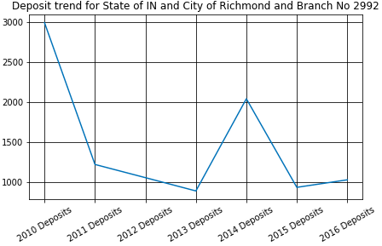
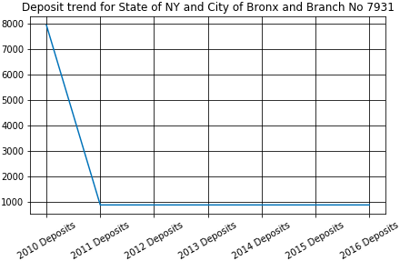
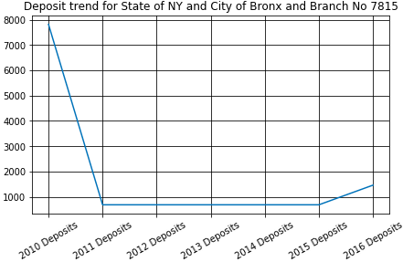
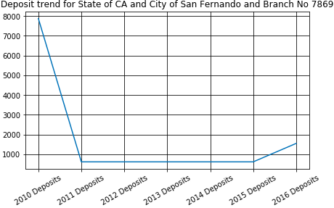
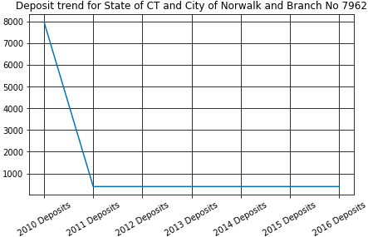
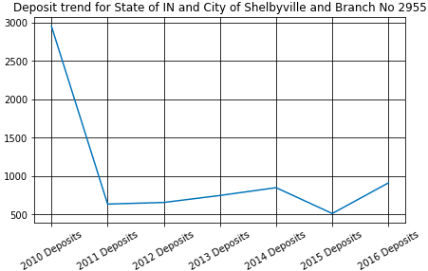
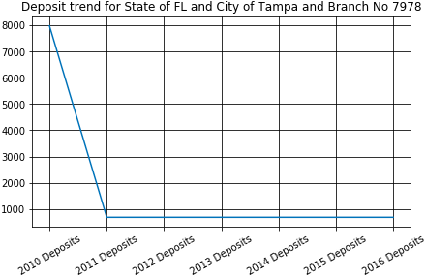
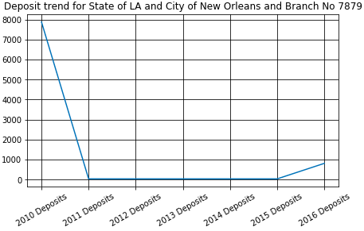
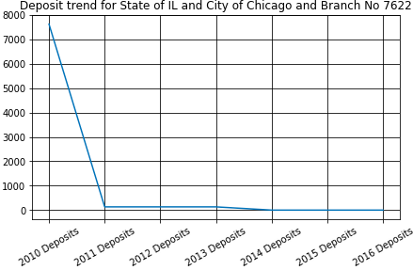
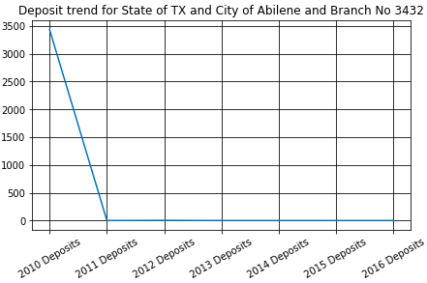
EXPLORATORY DATA ANALYSIS – YOY DEPOSIT TREND FOR LEAST10 BRANCHES
Most of the branches showing flat trend for most of the years recorded. However there are multiple branches showing a flat trend between 2011 and 2016 with a sudden fall from 2010.

Slide 10
BUILDING BASELINE MODEL WITH REGRESSION
One of the important business strategy is the ability to predict potential deposit a branch could generate for the business over a period of time. It is with this intention we try to predict ’2016 Deposits’ feature for a branch basis it’s historical data like geographical position, age of the branch as of today, if Main office or not, if Acquired Branch or not and deposits gathered from the period of 2010 to 2015.
Training a model with seen data and testing the model on unseen data
The RMSE is the square root of the variance of the residuals. It indicates the absolute fit of the model to the data–how close the observed data points are to the model’s predicted values. Lower values of RMSE indicate better fit. RMSE is a good measure of how accurately the model predicts the response, and it is the most important criterion for fit if the main purpose of the model is prediction.

